Slide 1
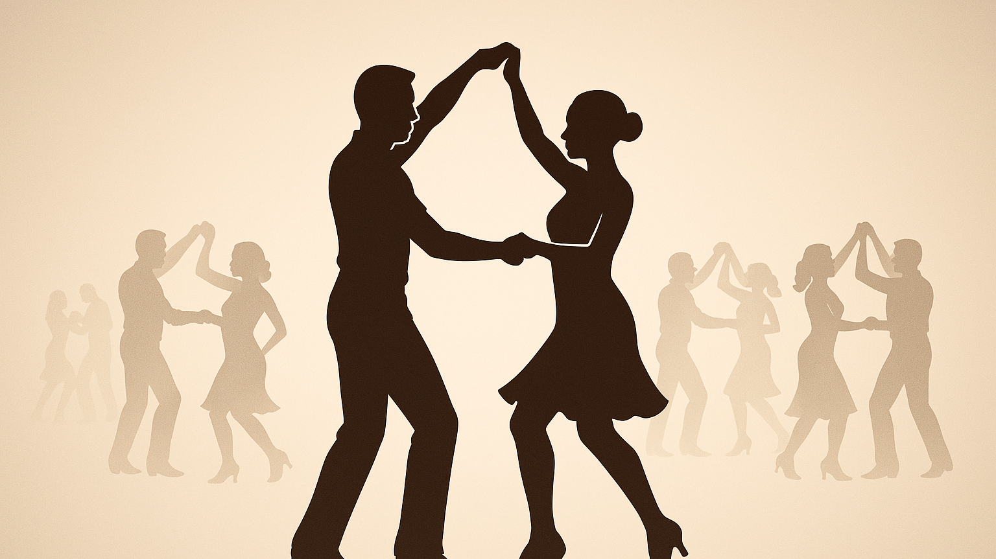
Social Dance AI Assistant
By
Arda Melikşah Demir

Slide 2
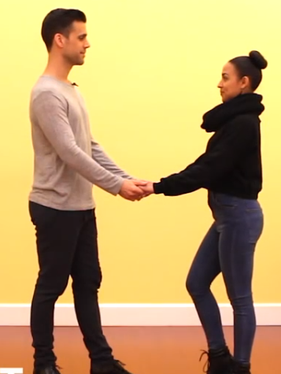
What Exactly is Social Dance
No coreography.
Leader & follower
Dance is lead by the leader through some hand signs.
Follower follows these hand signs.

Slide 3
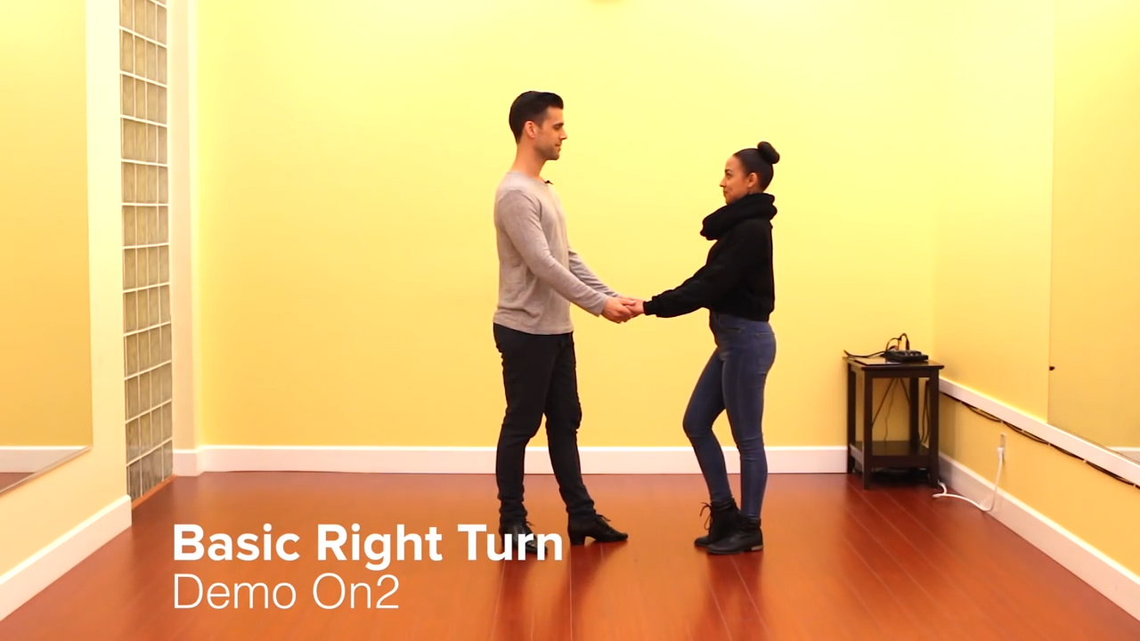

Slide 4
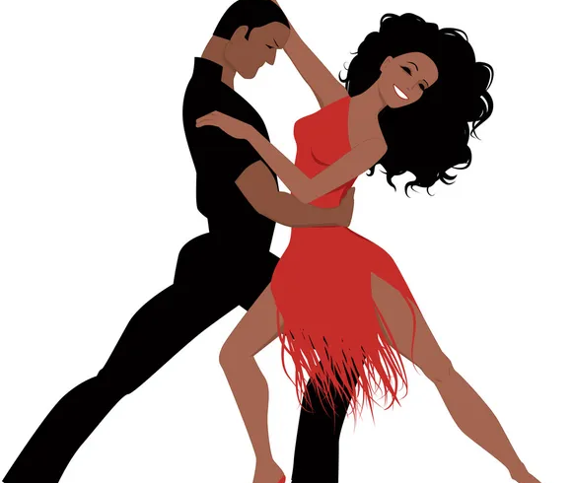
About Salsa
Millions of salsa dancers around the globe.
Some papers makes an estimation of tens of millions[1] while others make hundreds of millions dancers [2].
One of the most popular dances.
New people starts dancing every single year.

Slide 5
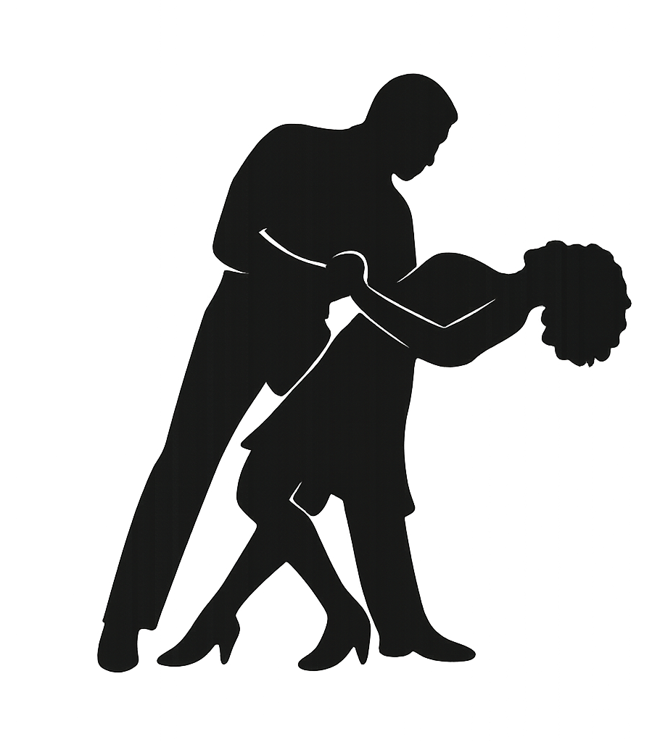
Problem Definition
Best way to learn is taking courses and practicing.
Another way of learning is going to the dance nights and watching people dance.
Not easy to learn only by watching.
No tool for learning.
https://www.youtube.com/watch?v=z_Qw3fZRQ24

Slide 6
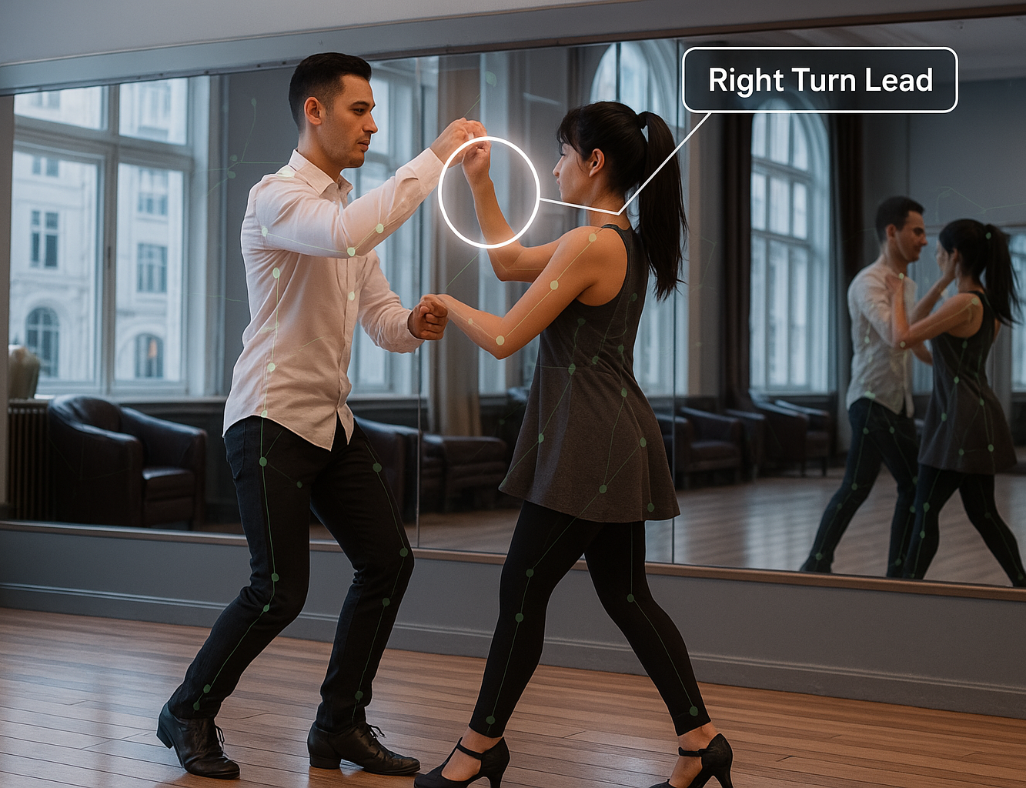
Solution
A website or mobile app that enables people to upload social dance videos through YouTube or mobile device.
Model returns the same dance video with tutorials and bookmarks throughout the video.

Slide 7
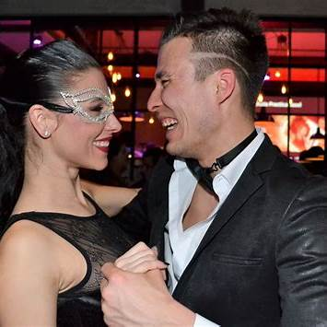



Available Applications
While there is papers and studies on detecting steps and solo dance.
The study itself doesn’t take partnered dances into account as well as no tool for commercial use.
There are tools that offer tutorials or shows dance events nearby but none of them offers an unsupervised assistant that analyzes videos automatically.

Slide 8
Architecture
Web page/ App for uploading the dance video.
Server sending the video to model computer.
Video processed through the OpenCV-YOLOv8-OpenPose.
Dance moves in the video detected and classified.
Video uploaded back to the website with tutorial.

Slide 9
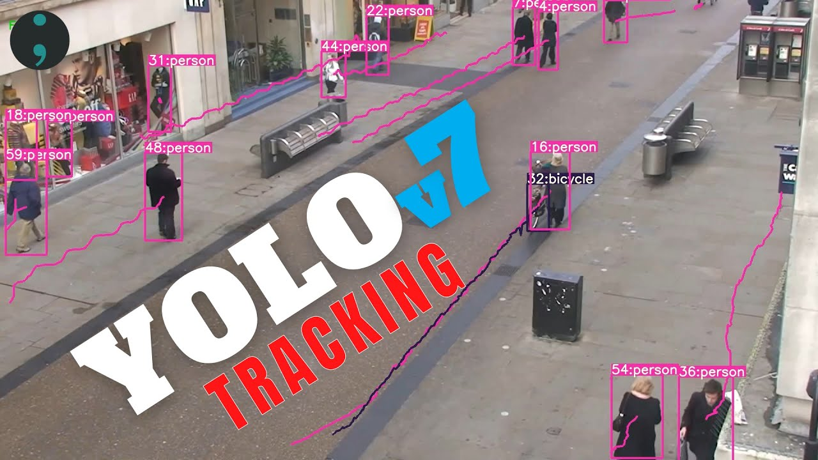
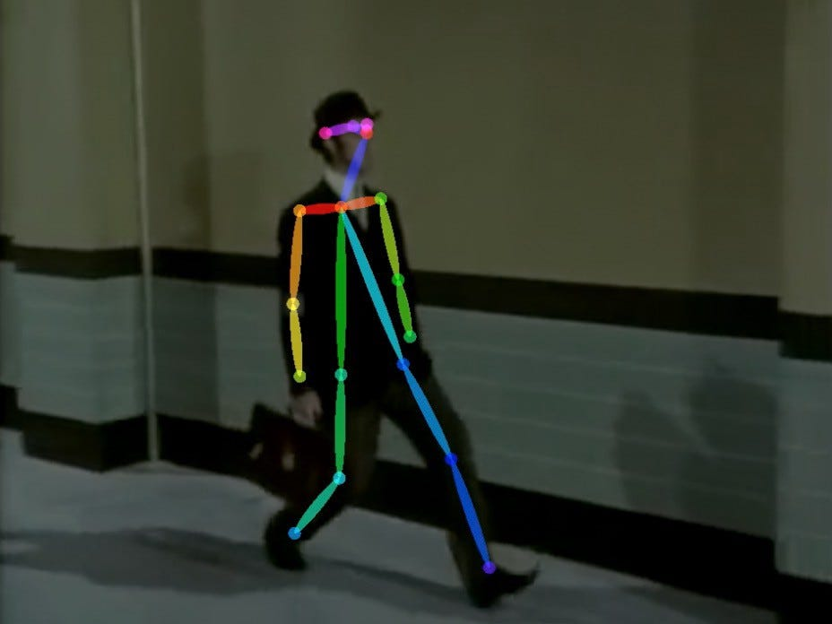

Technologies
Models available that follows human body parts or follows humans or detect man/woman.
OpenCV
YOLOv8
OpenPose

Slide 10
RoadMap
Feature Extraction with AI Models
Body parts, step count, leader follower tracking and identifying.
Data Set Preparation
Classifying the Dance Moves in the dataset
Building the model for classifying.
Building the Website

Slide 11
Challenges
Social dance dataset.
Model for classifying dance moves.
Model that tracks; human, gender, body part.

Slide 12

Progress

Slide 13
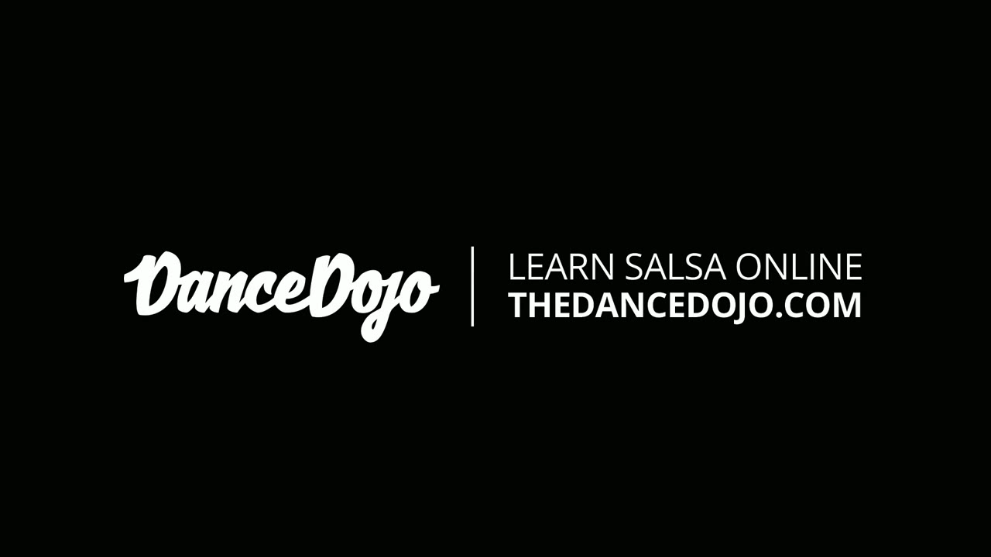
Progress

Slide 14
Thanks For Listening

Slide 15
References
[1] https://www.newindianexpress.com/magazine/2017/Oct/14/the-salsa-sage-1672624.html#:~:text=%E2%80%9CI%20grew%20up%20as%20a,Rhythm%20Dance%20Academy%20in%20Bengaluru
[2] https://rfdance.com/blog/12-little-known-facts-on-salsa-dancing/#:~:text=Salsa%20isn%E2%80%99t%20just%20popular%E2%80%94it%E2%80%99s%20the,world%E2%80%99s%20favorite%20partner%20dance

